Slide 1
K.A.G.E.
Killer Application / Gaming Extension
Eric “Scanner” Luce
SegaSoft Networks Inc.
Notes:
This presentation covers the basics of how a developer would use Kage to write a multiplayer network game. While doing so it uncovers a bit of what is under the hood in the hopes that a better understanding of how all this magic happens will help developers to understand the system and how to use it better.
We then show a sample UI in slides (and an AVI if we can manage that)
We then go a little bit in to a network gaming service that uses kage and what it offers.
We then go over some of the plans for the future.
We finish up with the FAQ and go on to the demo part of our show.

Slide 2
Table of Contents
What is Kage?
Anatomy of Launching a Network Game
The Kage Client API’s
The Kage Server API’s
A Sample Lobby UI
The Kage Gaming Service
Future Plans
FAQ

Slide 3
What Is It?
A Client and Server SDK To Write Games For a Gaming Network
A Gaming Network Using K.A.G.E.
  Authentication, Lobby, Chat, MatchMaking
Well Placed Servers
  Message Rebroadcasting
  Game Server Logic
Notes:
KAGE is a toolkit for making multiplayer games running on an integrated game network.
The primary components that you will deal with is the SDK. When we say "client" and "server" we mean the functions that are being performed. Not where the code is actually running. Our API mostly consists of client functions - logging on, searching for games, chatting, lobby services, etc. It consists of a few API's for server based functionality such as posting scores, being the message rebroadcaster for a game. However, all of the client API's run on the actual dreamcast as well as running on the "server hosting" machines. You could have a game server that joins lobbies and chats, for instance. The "server" API's could run on your clients as well.
The gaming service, although this is not really "K.A.G.E.", this is probably the most important thing that we offer to the developers - a network of machines that provide the authentication, lobby, chat services so that they do not have to.
Part of that same offering but different enough in its own way to warrant a bullet point is that we offer servers that are well placed all over the network to give the game developers optimal latency for message rebroadcasting. These servers are also intended to host game logic if the game developer desires to write a standalone server. All of the KAGE API's that they use on the client work very well on the server.

Slide 4
What Is It Not?
Not Really a Methodology For Game Protocol Definitions
Not Really for Persistent, Massively Multiplayer Games
Notes:
KAGE itself is a set of tools that give the game developers all the services they need to create a game inside of a rich gaming network. The actual game protocol has to be up to the individual developers. We provide a module (The CMI) for handling the actual network-traffic portions of a game easy but the real work of how the game clients communicate with each other up to the network is up to the game developer - It has to be.
That being said we do offer sample code, advice, and
a lot of experience on how a game developer may wish to structure their game protocols, or even their event loop with respect to how it uses the network.
Most persistent, massively multiplayer games are so specialized that they need a rather large infrastructure just for the game itself. We spent our effort on the structure that most multiplayer games need to get off the ground instead - a lobby service, a chat service, a game instance launch service.
We have services that massively multiplayer games can certainly take advantage of - authentication services, game instance location services, chat services between players inside the game and outside of the game, etc.

Slide 5
K.A.G.E Goals
Scaleable
Cross-policy network ability
Allow multiple entry points for the developer
Cross platform portability in mind
Modular allowing for expansion
Notes:
Goals - scaleable - we want to have no limit on the number of simultaneous players the network can support - provided the majority of the players are performing common functions - browsing lobbies, chatting, creating/playing games, etc.
ie: you do not have 10,000 players trying to get in to the same lobby.
Cross-policy network ability. What does this mean? It is a bit complex to describe but it is part of what the above goal enables.
We are after a network that has no hard partitioning built in to it. The partitioning is all policy or social dynamics. If your network can be very large you could have enough room for multiple gaming networks - on the same network. Then the partitioning between these networks is up to the business policies of those running them. Say heat.net and the dreamcast network both use Kage. The only reason they could not talk to each other on a server by server and client by client basis has nothing to do with the authentication system used for each.. it has to do with what permissions each server or c lient grants entities authenticated by some other domain.
I expect a lot of questions on this one and not many people walking away with the true sense of this ability.
I also expect many companies to view this ability with fear and dread.
Allow multiple entry points for the developer.. this means that you get all the API's and you can pick and choose which ones you use and what UI you present. Things like heat.net, mplayer, gamezone, battle.net live by the rules that they define the experience up to the game launch.
This imposes a greather burden on the game network provider and the 3r dparty developer as they have to agree and support each other a lot more. With the Dreamcast platform this is par for the course. In the pc gaming world the gaming network provider will probably need to create a lobby/launcher shell to invoke the 3rd party program.
Cross platform - MPATH, DPlay are windows based. Extremely windows based. It is difficult to imagine running these clients under shinobi or unix.
A game play API is really simple. It is very function-oriented. A C library can encompass the basics of all the communication. Since we make it work for this simple environment it ports nicely to Win32, unix, et al. What is more we can even use it as a service provider for DPlay and DLobby, or we can add a nice object layer on top of it all making it more palatable to other languages such as C-- and Java.
Modular - some modules rely upon others, but major modules do not rely upon any other module. You can use the CMI without the session, lobby or any other service.
You can use the chat service without the lobby or cmi service, etc.
Because we separate the API's on paradigm we can add more as we see fit.
With the ESI we can actually add support for arbitrary services without understanding anything about them in advance (yeah, you do need to know the protocol to talk to them, but you do not need to know how to connect or locate them..)

Slide 6
The Path to Playing Online
ISP Connection
Login
Lobby/Chat
Gameroom/Chat
Game play
Connect to ISP
Login
Lobby/Chat
Gameroom/Chat
Game play
Notes:
What does it take, for a user, to actually get in to a multiplayer game.
After looking at many systems out there it turns out there is pretty much only one common path to actual game play. Some exceptions aside it tends to look like this. You login, go to a lobby to find players, enter in a game room to set up the game, and then begin game play where theoretically you will spend most of your time.
Everything in the grey box is what the Kage toolkit provides you. We provide you with support to connect to an ISP. Our "gaming service" actually offers an ISP, all the way through a protocol for your game to use as well as launching teh game server, and providing a way for the game server to communicate scores back to a game room.
Note that you do not necessarily have to go through a lobby or a game room to engage in game play. Some of the most popular games skip some of these steps giving the user the most streamlined path to the actual content - the game.
For example - Blizzard's battle.net for Diablo. You have login, lobbies, chat, and then game play. There is no traditional game room to speak of. If you look at gamespy - most of its games are either login goes directly to game play, or if there is a game room or chat it is either within the game itself or from some external service such as EGN or RogerWilco.
Also the path for someone joining an existing game they know about is going to be different from someone who has to gather players, setup the game, and then launch it.

Slide 7
Table of Contents
What is Kage?
Anatomy of Launching a Network Game
The Kage Client API’s
The Kage Server API’s
A Sample Lobby UI
The Kage Gaming Service
Future Plans
FAQ

Slide 8
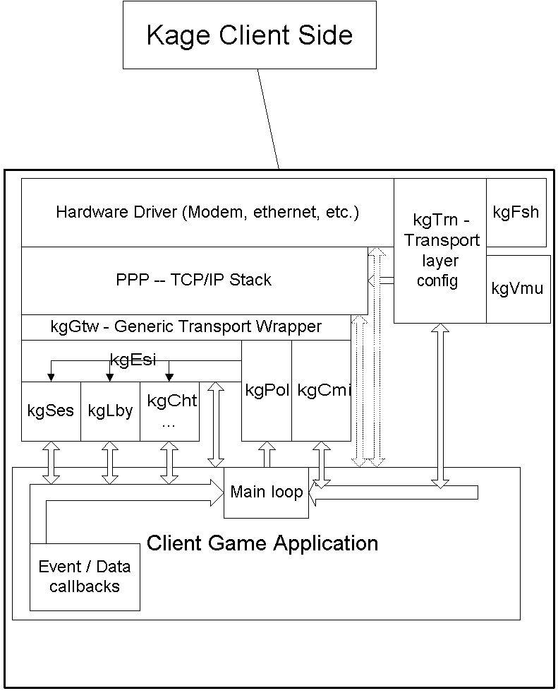
Client Picture
API’s that client uses are modular
kgGtw lets us abstract on top of any stack
kgTrn lets us abstract with any hardware
kgEsi lets us abstract any type of transaction based service
kgCmi customizes network path for clients
kgPol lets all API’s support a non-threaded environment

Slide 9
What is in the SDK?
(kgFil - the kage flash file API)
kgFil/kgTrn
  Manages Network Connection Info and KAGE User Info
  Stored in SegaSoft area of Flash or in VMU
  Will be used to manage space need by features such as “InstyStart.”
Notes:
In truth you really only need to kgTrn API. This API uses the kgFil API under the covers to find what "stored connections" exist on your dreamcast.
The typical home is likely to have just one stored connection in the flash of their dreamcast. We are flexible here in allowing for more than one for several reasons.
First - it makes it a lot easier for developers. For developers we even let you store this information on to a VMU. Not a function we expect to enable for the average end user.
Second - you may actually have several different connection types.
We have a lot of plans for our area of flash. This is why we have a flexible file system API so we are not hard wired in to set fields that will cripple us later on.
For instance - we plan on being able to store information in flash that lets us jump from one part of the network to another, even through a reboot, by storing the users temporary session key and enough destination information for the client to reconnect and go directly to that destination.
Very useful when you were browsing lobbies using a generic chat program gd-rom and then wish to switch directly to a specific game gd-rom having found the game you want to join. This avoid the trouble of having to search for that game manually once you re-enter the network.

Slide 10
What is in the SDK?
(kgGtw - the Generic Transport Wrapper)
POSIX subset tcp/ip stack interface
Allows us to change stacks transparently
Adds convenience functions for asynchronous DNS lookups as well.
  kgGtw_gethostbyaddr_a, kgGtw_gethostbyname_a, kgGtw_cancelhostlookup
Notes:
For those of you who have dealt with both the PlanetWeb and the Access stack you have undoubtedly come head on in to problems where either the stack implementation is not complete, compliant, and definitely does things differently than the other choices.
We had to have KAGE work with pretty much any of the stack choices but we did not want to fill our code with "#ifdef"'s for every stack we came across. The situation would rapidly become unmanageable.
Instead we wrote this wrapper layer called the GTW. The Generic Transport Wrapper. It gives our applications a consistent POSIX level API we can write our code to and the more POSIX compliant the underlying stack we use is, the thinner our layer becomes. On Unix the layer is a bunch of macros that essentially vanish at compile time.
We added one extra feature to the GTW that is outside of the POSIX specification. Since DNS lookups are traditionally blocking function calls we added calls that let you resolve a host by name or by address asynchronously. You call one function to initate the DNS query and a callback you pass in gets invoked when the query is resolved by the network. If you feel the query is taking too long you can cancel it. This lets your game main loop continue to function even when you are trying to resolve host names.

Slide 11
What is in the SDK?
(kgSes - the User Session API)
kgSesLogon(user, password, *user_id )
  Log a user on to the network. May be called more than once.
  First user is the “primary” user.
kgSesLogonAnonymous( *user_id )
  Log an anonymous user under the primary user
kgSesLogoff( user_id )
Notes:
The session API is how you establish a session with "the gaming network." In other words, this is how you login.
We assume you got the user's name and password from the kgFil API, or asked them to enter it on the console.
After you have connected to the user's ISP vis the kgTrn API you then logon on to the gaming network. You can actually have multiple users share the same ISP connection. This is for scenarios where you have more than one local player on a console yet they each want to have a distinct identity.
The first player to log on to the network using kgSesLogon() is considered the primary user of the console/connection. All of the other players who logon are considered to be subservient on the connection to the primary user for many functions.
However if you have other users who wish to log on to the network, but wish to be anonymous or have no account then you can use the 'kgSesLogonAnonymous()' call. It is important to note, though, that these are considered to have the same identity, more or less, as the primary user.
When the user wishes to say that they are formally logging off the network it is nice to call "kgSesLogoff()" for each logged on user. This lets us properly close all credentials associated with a user and mark their session as over
These functions operate like a built-in state machine. Since you can do nothing until a logon has completed you have to keep calling the function. It will iterate through various states. Your logon will have been completed successfully when the function returns KGSES_INIT_BOOTSTRAP_SUCCESS. All of the failure codes
are less than 0 so if you get a negative return code from Logon, or Logoff then you can examine the return code more closely to see exactly what the cause was.

Slide 12
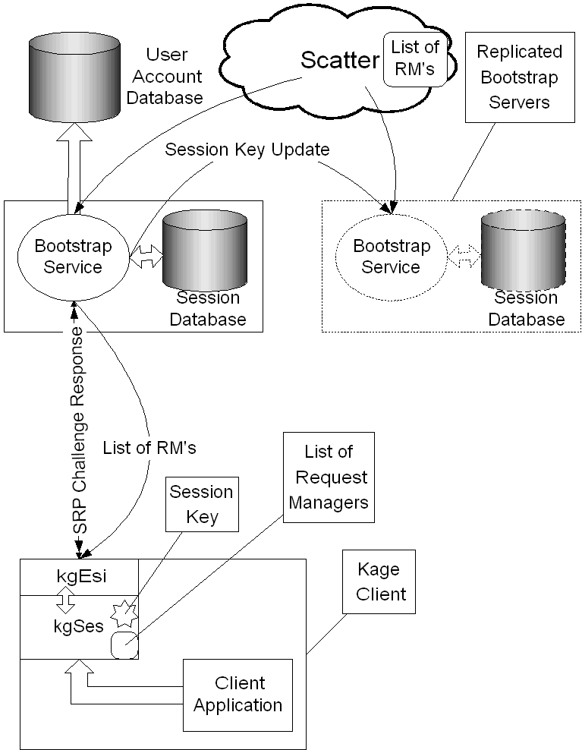
Where are we Really?
(log in to the game network)
Establish a Connection to the Bootstrap Service
Validate Game Network Credentials
  More Than One Game Network Account?
Receive Information About the Game Net
Notes:
(I initially had the picture in the same color scheme as the rest of the slides, but it became totally unreadable.)
So, what we have done so far on the undercovers of KAGE?
We have connected to the internet via the kgTrn API.
Then we invoked the kgSes API to log on to the network.
What this did is it talked to one of a set of special servers known as the bootstrap servers.
It authenticated you with the bootstrap server using SRP (Secure Remote Password) protocol to make sure your password never travelled over the network in the clear.
The bootstrap server validates that you are who you say you are and creates a session key that you can use to authenticate to other KAGE network services. Your client will use this session key without you ever knowing it. It is part of how it authenticates during a connection to services.
This session key is then passed down to your client. Then the bootstrap server does one more thing - it sends your client a list of "ESI" services that exist on the net close to you.
An ESI service is what you can use to get any other sort of service that Kage may offer.
After the bootstrap server has done this it logs a record and you are considered "logged in" to the network. Your login will remain valid until your session key expires or you tell a bootstrap server you wish to log off.
The bootstrap servers are replicated for performance and redundancy in at least two separate physical locations.

Slide 13
What is in the SDK?
(kgLby - dealing with lobbies)
Searching for and Joining Lobbies
  A lobby is an in-between place where you look for other players or existing game rooms to join
kgLbyFind() - to search for lobbies
  callback is invoked as they are found
kgLbyJoinLobby() - to join a found lobby.
Lobby info in the KgLobby structure
Notes:
Okay. Lobbies.
Lobbies are an in-between place. This is where you look for other players to form a game and play in it, or perhaps look for game rooms that already exist.
In order to join a lobby, you have to look for lobbies. There are at least two functions you can call to do this and there will be more that offer more powerful searches.
But for now it is best to stick to the simplest function: kgLbyFind( type, ping, game_class, name, user_id, tag)
The "type" tells us what you are looking for.. a lobby, a game room, or a game instance.
Once you send this query off you will start getting callbacks on the kgLbyLobbyHdlr() you defined when you initialized the lobby API.
The server will not tell you about all of the lobbies. Just a certain number that match your query.
Once you have the handle on a lobby you join it via the kgLbyJoinLobby() call. Once you join a lobby you will begin to get a number of callbacks telling you who is in this lobby, what games were announced to this lobby, etc.
It is important to note that lobbies have moderation facilities as well as access control lists. If you have administrator priveleges on the lobby you can kick people from the lobby, ban them from returning, or set the ACL's such that they can not see, or can see but can not join the lobby. You can also control who has administrator priveleges on the lobby.
Note: You have not joined the chat associated with this lobby, though! You will need to explicitly get the convo id
of the chat room associated with this lobby and join it using
the kgCht API discussed on the next slide.

Slide 14
What is in the SDK?
(kgCht - dealing with chat rooms)
Find the Convo (chat)
  from the Lobby structure
  from kgChtConvoFind( name, user_id, tag )
Messages can have a thread & media-type
You can ignore users or words
Administrators can kick, ban, and otherwise control the ACL’s for a Convo
Notes:
You really do not need to search for chat rooms if you are following the standard game plan. You can get the handle for a chat room, called a "convo" in Kage, from the lobby or game room you may be in.
However, since convos exist on their own you could do a search for them using the "kgChtConvoFind()" function. It looks for a chat room that has the name you pass to it.
Once in a conversations obviously you can send and receive messages. However there is a lot more to it than that. You can tag each message as belonging to a "thread." Sort of like a sub-conversation on a topic. You can ignore specific threads if they are cluttering up your screen too much.
You might use a thread, for instance, if you were using a shared Convo between users inside and outside of a game. The users outside of the game may wish to ignore specific game chat messages that are sent tagged with a certain thread.
Also, like a lobby and a game room people on the adminstrative ACL can control who can see and who can join the conversation. THey can also lock it with a password as well as kick and ban players from the conversation.
Every participant in a conversation can specify a list of words or users that they wish to be filtered. The administrators of the conversation can also specify a word list to be filtered for the entire conversation. All of the filtering happens on the server side.
The messages are all packet based and as such as not well suited for streaming media such as video and audio. However each message can have a media type such as 'text/plain' or 'text/enriched.' At this time, however, we offer no services to interpret these media types so it is more or less up to the clients how they wish to interpret the data. Currently we suggest sticking with text/plain for now.

Slide 15
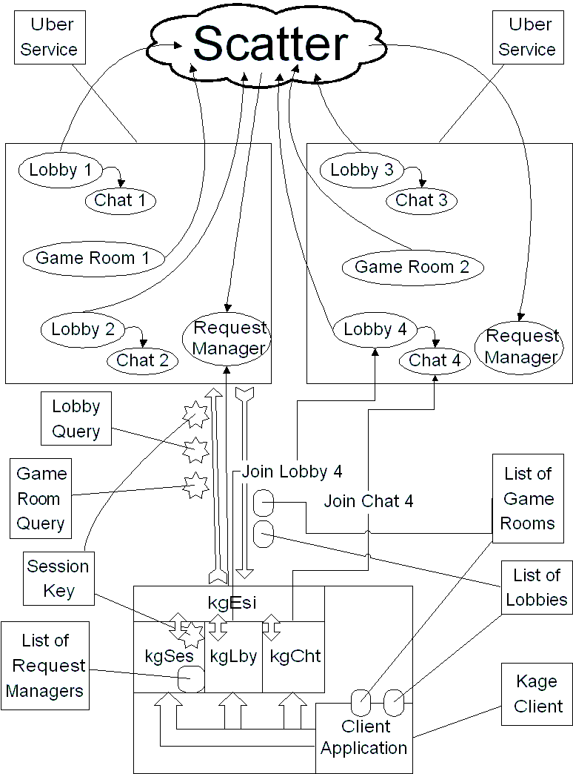
What Did That Just Do?
(kgLby and kgCht did what?)
Issue a Query For Lobbies
Get Lobbies from the Game Network
Let User Pick One / Or Pick One For User
Join Lobby / Join Associated Chat
Issue a Query For Game Rooms
Notes:
Well, it is really kind of messy if you look at it all put together like this.
What happened was that your client sent a query off to the server. The server took this query and asked other servers that it knows about through this mildly distributed database called Scatter. As answers come back the server formats these in to messages to your client.
Your client then chooses a lobby to join. It does not matter what server this lobby is on. Under the covers the client will open a new connection to a new service if it has to in order to connect to the lobby you just requested.
The same goes for the chat room. Your client pulls the chat room identifier out of the lobby structure and then connects to the appropiate server and joins the chat room on that server.
All of these connections and queries are authenticated by the session key your client got earlier from the bootstrap service. The request manager is actually a service that you can potentially in future versions of the API ask very generic and powerful questions of, such as "where is are the people on this buddy list? are they signed on? what lobbies, game rooms, or games are they in?"
You may wonder why we have this separation between lobbies and chat rooms. We will get in to this in a little bit but you should be able to guess the basics already - mainly chat rooms can exist on their own, and you could have a chat service without lobbies or game rooms.. or use a chat room to talk between players in a game and in a game room.. or lobby.. or unrelated chat room.

Slide 16
What is in the SDK?
(the other half of kgLby - game rooms)
Searching for Game Rooms
  kgLbyFind( KGLBY_ROOM, … );
  kgLbyCreateRoom( … );
  Game rooms announced to a lobby
kgLbyJoinRoom( … );
kgLbyGrabRoomKey( … );
kgLbySetGameSetting( … );
Notes:
There are three common ways to learn about a game room: You can search for them, like you searched for lobbies. Instead you would search for objects of type KGLBY_ROOM.
You can create a game room.
You can learn about a game room whose creation was announced to a particular lobby.
In many other gaming networks rooms are inside of lobbies. In Kage you can present that appearence but in reality there is no link between a game room and a lobby.
When a user creates a game room they can choose a lobby to broadcast this creation event too. All users in that lobby will be notified of that creation. This appears like any other callback that the user may get from a query for game rooms.
There are two principles at work here in this design: First, people who are in the same lobby tend to be there because it matched their lobby search criteria which by default also contains a latency measurement. So all of those users are with roughly the same latency horizon. So a query for game rooms that they issue will also result in a very similar result set. What is more, if one user creates a game room they can broadcast this creation to a specific lobby to make sure that users in that lobby can see that game room, regardless of whether or not they have issued any queries for game rooms.
Like lobbies and conversations (chat rooms) you can kick, ban, lock and control the view & join acl's if you are an adminstrator.
Like lobbies, each game room has a reference to a conversation (chat room) you must join the chat as well after you have joined the game room in order to see messages sent to it by other users in the game room.
There is some additional functionality that is unique to a game room. Every game room has a "key." Only one person in the game room at a time can pick up the key and be the key holder. The Key holder can do some of the functions of an administrator - namely - ban, kick, lock, and change the view & join acl's.
The key holder is also the only user that can change the game settings and launch the game instance.
Every game room has associated with it two blocks of information. One is the game settings. This is a table of key/value pairs (both are strings.) This table will be passed to the game instance when it launches. This is how you get to set various attributes of the game instance.
It is important to note that the game settings become immutable (read only and unchangeable by everyone) once a game has been launched.
The other block of information is the 'game info.' The game info can only be set by the game logic server once the game has started. The game can use this to display data from within the game to users that are still in the game room.
NOTE: We do not impose any semantics on the key/value pairs for game settings and game info. It is more or less up to the game developer to figure out how they want to parse and format these strings in to settings for their games.
As time goes on we will undoubtedly include in all of the Kage documentation recommended keys to use such as "frag limit" or some such.
In order to launch the game instance the key holder will need to ask the ESI (the External Services Interface) to create a new service of the appropiate game class.

Slide 17
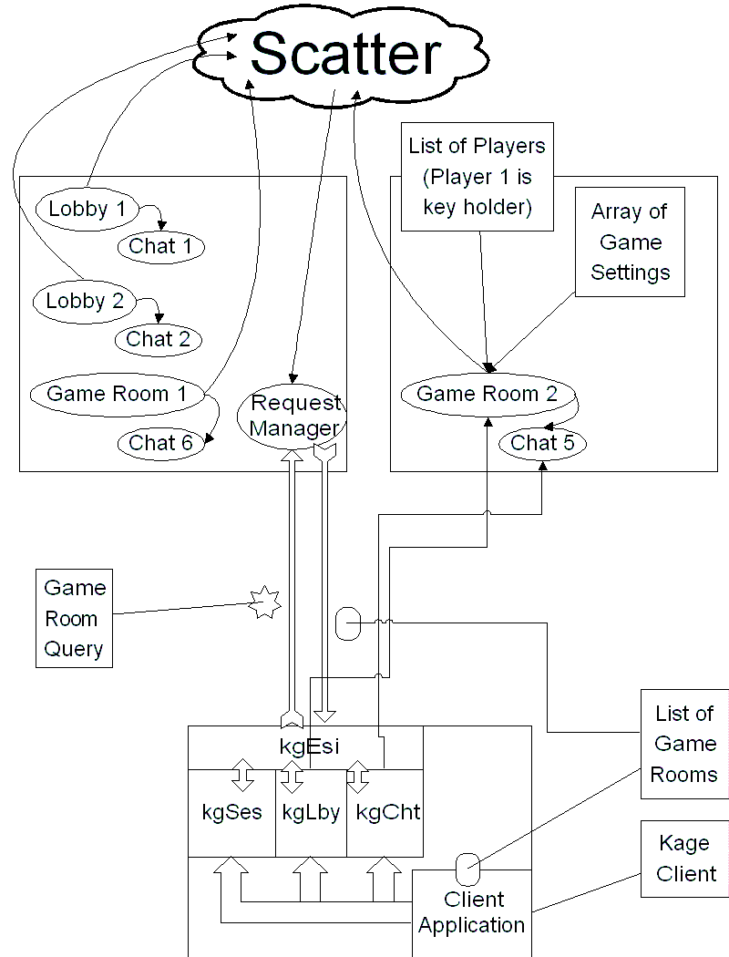
Setting Up the Game
(the game room & settings)
Query for Game Rooms
Join a Game Room
Join Associated Chat
Grab the Key
Set Game Options
Marshall the Squirrels, er, Players
Notes:
What actually happens on the network when you query for game rooms, select one, and then join it?
In many ways it is very similar to what happens when you are doing the same for a lobby. You can issue a query or somehow learn about a game room.
When you get a game room handle, no matter where it came from, you issue a request to join that game room. The underlying library figures out which server that game room is on, connects to it, and requests to join it.
Once you have joined it will you begin to receive callback notifications of events going on in that game room. You probably want to get the handle to the associated conversation (chat room) and join it.
In the game room you can grab the key, if no one else has it. If you have the key you can set up game settings and control some moderator settings on the game room.
If a game is already in progress the user can call kgLbyGetGameInstanceId() in order to get the game instance id.
NOTE: You do not actually launch teh game instance using any function defined in the game room/lobby API. You use a function in a separate API, the ESI API.
This was done to help cleanly separate the lobby, chat, game room functions from launching a game instance so that it is possible to launch or find an already running game without needing the lobby/game room paradigm. (See the next couple of slides for

Slide 18
What is in the SDK?
(kgEsi, kgCmi - launching the game)
kgLbyGetGameInstanceId(room, game, ...);
  Gets the instance name of our game service.
kgEsiRequestService( type, game, … );
  Asks the ESI to start up or find this instance.
kgEsiInitGameID( …, &game_id );
  Turns the ESI response in to a game id
kgCmiCreate( game_id );
  Tell our CMI client what to connect to.
Notes:
How do you launch a game?
In effect this is a simple operation. Here we use the ESI. The ESI stands for the "External Services Interface" and is the API that for now you only use in this one case. The ESI is used to either launch or find a service somewhere on the network.
All services are specified via a triple: The service type (a string), the service instance (also a string), and the service id (an integer.) The service id will amost always be 0. It is used if you need more than one instance of a specific service. For instance if a specific game instance needed two separate message rebroadcast managers.
You ask the ESI to create or find an instance of a certain type of service. When the ESI finds or creates that service it will invoke a callback you give it. You translate this ESI service handle in to a format that you can grok, namely an ip address and port. You pass this address to your actual game play code and you are off.
In the slide I use the game play messaging API that we provide as part of the Kage toolkit - the CMI (Common Messaging Interface.)
In this case, we want a CMI rebroadcast server to be created for us by the ESI.NOTE: In CMI terms, the rebroadcast server is called the "session manager." The Kage service type that is a vanilla CMI is "KageService:CMISesMgr."
You get the "instance name" for your service by deriving it from the game room. Hence a call someting like: "kgLbyGetGameInstanceId(room_id, game_instance, STRING_SIZE);"
Once you get a callback from the ESI you have an ESI control block usually used by the ESI for sending and receiving messages. However in this case we do not wish to use the ESI for sending and receiving messages. We want to use a custom API specifically designed for game traffic. What we want is the ip address and port of this game service so we can talk to it directly. This is what the call "kgEsiInitGameID(kics_service, &game_id);" does. When it returns we have a structure (game_id) that we can deal with directly.
In our case our custom game protocol is going to the CMI so we initialize it. At this point in time we can begin the main game play part of our game.
In the future this whole sequence of calls will be wrapped in to a convenience function so do not be too daunted by the details. We have concentrated on the basic raw functionality so that it works properly over making an API that hides too much of the details from the game developer. Once this is done we will take the most common paths and wrap them so that a game developer who is following a common path can invoke the higher level functions and not worry about the handoffs between modules.
NOTE: All of the clients execute the exact same set of function calls! Everyone simply asks for a service of a certain type and specific instance. The ESI waits until the user in the game room that has grabbed the key asks before actually launching the game. Once the key holder asks the ESI for a game instance the ESI takes the set of all the users who have asked for this game instance and finds the server which has the best latency for the and then launches the requested service on that machine.
This means that all of the other userse who have requested this service from the ESI will not get a callback until the key holder also requests the same service or the time out they have specified with the ESI has passed.

Slide 19
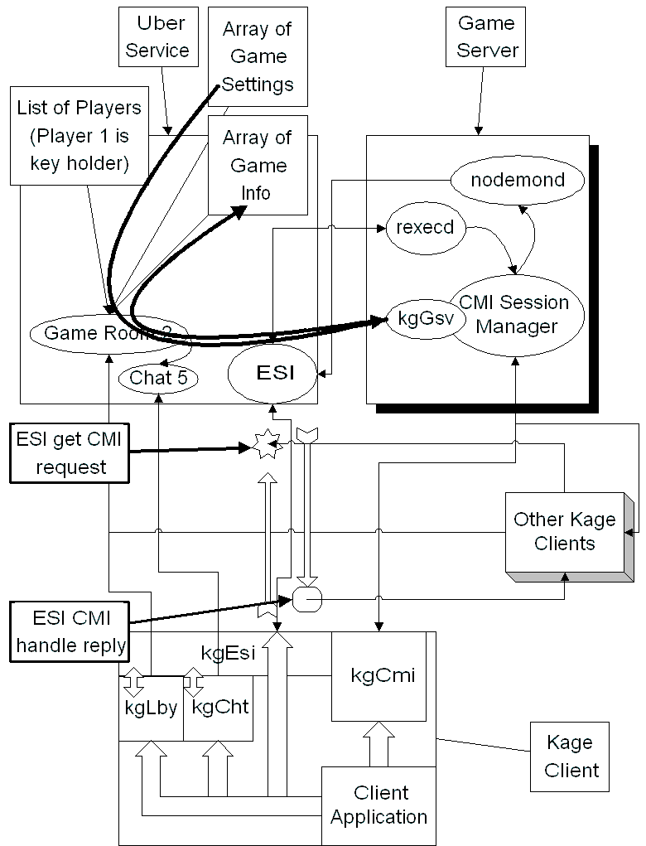
Details of Launching the Game
(esi, servers, and clients, oh my!)
Request the Network to Start the CMI Session Manager
Wait Until Request Returns
Initialize CMI Session with Returned Information
Have Game Server Get Settings via the kgGsv API
Start the Game Loop
Notes:
What actually happens on the back end when users launch a game instance? "A lot happens" to put it mildly as you can see by the picture on this slide here.
The client requests the ESI service to start a service of type "KageService:CMISesMgr." The ESI queues up all the requests from different clients until the key holder asks for this service. The ESI then goes to the match maker to find the best server out on the net to host this service. It then contacts that server and asks it to start a "CMI Session Manager."
Once the CMI Session Manager service has started it uses the kgGsv API (will be explained later in the 'server api' section of thi spresentation) to tell the network what IP address and port it has opened.
The CMI Session Manager also then uses the kgGsv API to get any game settings that were set in the game room by the key holder. At this point in time the CMI Session Manager is ready to accept clients and begin the message passing aspects of game play.
Meanwhile the ESI has gotten the information that the CMI Session manager posted via the kgGsv API. It returns this information to all the clients that asked for this service instance. If any new clients ask for this information it will now return it directly to them - this lets new players join a game already in progress.
The clients now take the information from the ESI, translate it in to an ip address and port and then initialize their game play API's with this information. The game can now start.
What is more - after the CMI Session Manager has started it can now post messages back to the game room via the "game info" block by using the appropiate methods in the kgGsv API.

Slide 20
What is in the SDK?
(kgCmi - game play messaging)
CMI - aka Common Messaging Interface
A game play message passing api
  Frees the programmer from knowing the details of connection level interfaces
  Server based message rebroadcasting features for free
  Peer to peer, reliable, sequenced, or stream with compression
  Similar in paradigm to DirectPlay. Easier to use already invested knowledge.
Notes:
In addition to authentication, lobby, matchmaking, and chat services we offer programmers an API for doing message passing during game play and a remote hosted service to do message rebroadcasting using this API.
This is called the CMI. This stands for the Common Messaging Interface.
The goal of the CMI is to free the programmer from worrying about the details of sockets, accept, listen, message buffering, udp vs tcp, reliable but unsequenced, sequenced but unreliable, compression, the actual network being used while providing a way to send messages to any number of other clients in a game efficiently, or to send a message directly to a peer in a game without going through a central rebroadcast server.
There are only so many models out there for network communication in any traditional sense. The CMI API uses a paradigm similar to that of DirectPlay. There are "players" and there are "groups." A group can contain a number of players or other groups. Messages are sent to a player or a group. When you send a message you set various flags to indicate if this message should be sent via stream, sequenced, reliable, to a peer. You can combine flags. However, if you send a message marked reliable as well as sequenced it is sent via a stream.
Reliable, sequenced, or NOT stream indicate a message is sent via a packet interface - aka UDP. If it is marked as 'stream' then it is sent via TCP. Unless the message is marked as 'peer' it will be sent through the rebroadcast server which is the CMI is known as the "session manager."
When a client creates a "player" object they can set various flags on this player indicating to the other clients in the CMI session how to treat this player. For instance, a player can say they are the "host." It is important to note that the CMI Session Manager is not necessarily the participant in the CMI session that is controlling the game logic. This is expected to be the use of the "host" flag on a player. If a player, which is just to say a message source or end point, is the game logic controller for the game then it should indicate this by setting the "host" attribute.
The other attribute is the 'observer' attribute. This is meant to imply to the other players in the CMI Session that this participant is not active and is merely watching the events unfold for whatever reason.
These flags do not actually mean anything to the CMI itself. They are there as a convenience to game developers so they do not have to waste time figuring out how to tell the other clients in a session who is the game logic server and who is just observing the game.
We also put in to the CMI some of the collective knowledge we have learned over the years with working with multiplayer internet games. Things like our compression technology called "RIPX Compression" that was developed for heat.net. We have seen packets run through this form of delta-frame compression reduced by 30% to 40% on average for PC based games. The most a packet will ever grow using this compression is 2 bytes. The compression algorithm is extremely efficient on a PC. We have not yet done any reasonable benchmarks on the dreamcast.
Of course the compression is optional.
We also have experience with making games on privately routed networks talk to games on non-privately routed networks while still using a peer-peer sending mechanism. The CMI will use this technique for determining proper addresses to send to on a client by client basis without the game programmer having to worry about that.
It is important to note that although we offer the CMI and CMI Session Manager services on our network to game programmers it may not be the best for their specific need. We feel that it will fill many needs and saves the programmer additional work. However by no means do we say that your games must use our game play protocols.

Slide 21
Why is Chat Separate?
(chat vs lobbies vs game rooms)
Separate services allow more flexibility
A chat service can be independent of a lobby
A game can share a chat without requiring the lobby API to be active
A chat service is actually used very differently than a lobby service is
Notes:
Early on in the design of Kage we separated the chat service from the lobby service.
Sure, pretty much every lobby service out there has chat integrated in to it. We can provide the same functionality by having the lobby have a reference to the chat.
However pretty much every game service out there is also monolithic. If you use any part of it you have to use all of it. Also if you just want to use a minor part of it, say, chat, you have to use the other parts of it as well.
If you just wanted access to a chat service why bother carrying around the lobby or game room service?
Also if you wanted to access a common chat room that is used by a game room from inside the game due to the way most other services tie the two together you have to leave the whole lobby API active taking up resources that you are simply not interested in during the middle of game play.
If you look at how it is used a chat service is quite different from a lobby or a game room. A lobby is for looking for players or game rooms. A game room is for setting up a game. By separating it out we can have the chat service concentrate on being what it is - a chat service. At the same time we can have lobbies and game rooms concentrate on their specific goals.

Slide 22
Table of Contents
What is Kage?
Anatomy of Launching a Network Game
The Kage Client API’s
The Kage Server API’s
A Sample Lobby UI
The Kage Gaming Service
Future Plans
FAQ

Slide 23
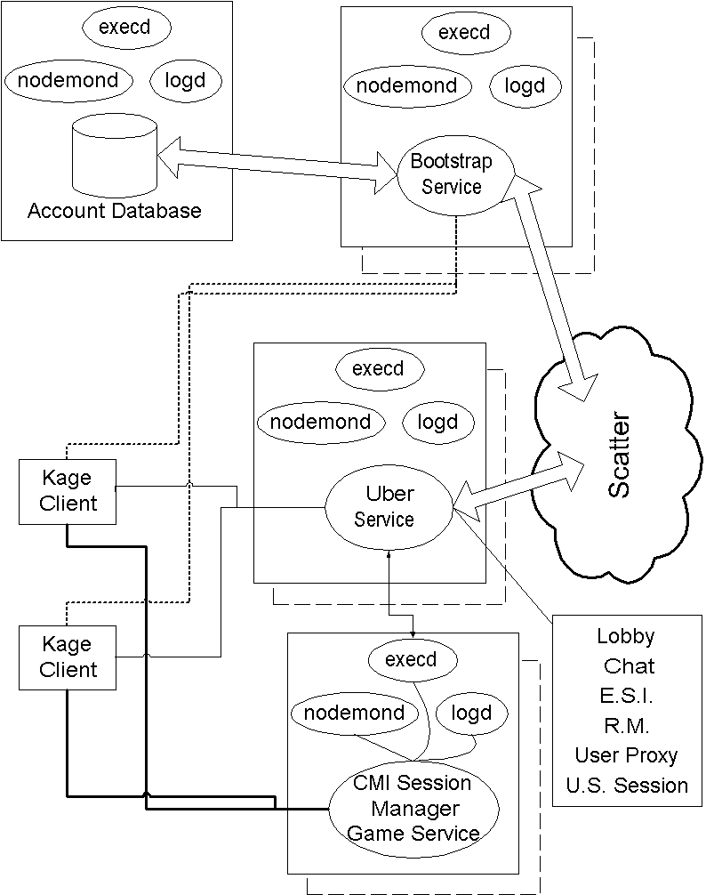
The Kage Server Side
Main User Account database
Multiple Bootstrap services
Multiple Uber Servers
  Lobby, chat, esi, rm, user proxy, etc
Multiple CMI Session Managers (and/or game servers)
Scatter used as discovery service by Uber Service and Bootstrap Service
Notes:
We have been concentrating on the client side API's and how to launch a game. We have been showing as well how each step in the client process interacts with various servers on the network.
Now we will move over to the server specific API's.
To give a little context here is rough overview picture of the client and server architecture (with more time spent showing all of the server components at once.)

Slide 24
What is in the SDK?
(kgGsv - the Game Service API)
So far the only specifically game server API
Serves two functions
  Game service publication and startup
    kgGsvPostAddress( game_id );
    kgGsvWaitForStart( timeout );
    kgGsvRetractAddress( void );
  Game setting retrieval / game info posting
    kgGsvGetGameSettings( room_id, tag );
    kgGsvSetGameInfo( room_id, key, value, tag );
Notes:
When talking about Kage we frequently get questions saying "which api's are for client work and which are for server work? It is not at all clear." Perhaps it is not clear because of the confusing use of the word 'server' and 'client.' To many people the word 'server' means some big box running at some ISP somewhere that has a lot of CPU and bandwidth and disk space and probably a database of some sort.
In terms of the API's, though, we say an API is a client API if it talks to some service (a process running on a box somewhere.) The API is a 'server' API if it is used to provide a service. In truth by this definition the GSV API is really a client API too, it talks to services as a client would. However its intention is different. The information posted through the GSV API is only available to clients via talking to another service (for example the ESI to get the game service's address or to the Game Room to get the game info posted by the game via the GSV.)
The main point is that a called a client API or server API not because of where it runs but because of how it is used.
We try to use the term "service" otherwise to refer some process running on some machine that offers services to a client API. We use the term "server" otherwise, when not next to the letters "API" to refer to an actual box on the network somewhere.
This API serves two functions. It may have been better to break this up in to two API's but there was enough interrelation between the two functions as well as confining all of this stuff to a single API makes it easier for the 3rd party programmer to keep track of what to use.
In order for a game service to be launched by our network on one of our servers it has to call our API to post its address so that clients using our gaming service know where to find it.
We offer the convenience function of "wait for start" so that a game server developer can know when their game has actually started. This serves a rather important purpose in a gaming network. It lets us pre-launch a bunch of game services. These game services go through all of the initilization they can before they need anything specific a running game. Things like allocating basic resources, establishing a network connection to listen for players on, etc. The game may sit at the "kgGsvWaitForStart()" call for quite some time before the signal to proceed is actually sent to the game service instance.
Once the game service has started, if it is running on a remote server, then it will need to fetch the game settings from the game room. This step is actually important and needs to be done even if the game service knows the game settings. By calling the function "kgGsvGetGameSettings()" they tell the game room that the game settings have become read only and can not be modified anymore by any player. This is important as it serves to be the initial state that started this game. This information becomes extremely important in support such things as tournaments and challenges where the starting game state has to be known.
While the game service is running it may wish to post information back to the game room that it was launched from. It can do this via the "kgGsvSetGameInfo()" function. This lets the game service set a key/value pair in the game room. All members of that game room will be notified of the information changing.
This is also an important hook in that latter scoring services to store scores persistently and manage such systems as ladders will be hooked in to the game room on the server side watching for game info being posted by a game service. This means that we can add support for that service later without requiring any changes to the game client or the game server as long as it uses the GSV for posting scores.
Of course a game does not need to post scores using the GSV. It does not even need to fetch game settings via the GSV if it knows them some other way or perhaps if there are no game settings to set.
However, in order for a server to run on our network it has to use the post & retract address functions as well as the 'wait for start' function.

Slide 25
What is in the SDK?
(kgCmi - The Server Bits)
What server functions are there in the CMI?
  Message rebroadcasting
  Client connection management
Functions:
  kgCmiServiceStart(session, func);
  kgCmiConnCbk( *session, *connection_data);
Notes:
As far as the API goes for the server side of the CMI it is very minimal.
It is more the function that is served than the API. In every CMI session there has to be at least one participant that is the session manager. This participant serves as the message rebroadcaster for all of the participants in the session. This could actually be one of the dreamcasts.
The message rebroadcasting services are done automatically by the CMI itself. The user only needs to declare that they are the session manager using the "kgCmiServiceStart(session, func)" call. The only other function is that they have to agree to accept any new clients in to this session. The "func" in the service start call will be invoked every time a client connects to the session manager. The session manager has the option of refusing the connection if it wishes.
Although any participant can be the session manager we strongly recommend that you use a host with a higher bandwidth and more cpu than a dreamcast. Having all the other clients send their messages to this one unit to be re-sent out to all of the other clients can get wasteful and way too much data for a modem to keep up.
The Kage network service actually offers a CMI Session Manager as a service that can be used by any client of the network. This lets developers take advantage of our network of well placed servers.

Slide 26
Table of Contents
What is Kage?
Anatomy of Launching a Network Game
The Kage Client API’s
The Kage Server API’s
A Sample Lobby UI
The Kage Gaming Service
Future Plans
FAQ

Slide 27
A Sample Lobby UI
A Lobby
A Game Room
A softkeyboard for chat within a game room
Zooming out to browse different lobbies
The ability to switch between different game rooms and lobbies easily while remaining in them.
Notes:
Here is a sample UI that we are working on. These images are from the artists work and are being integrated in to the sample game. The two do not quite match up yet but they are getting pretty close.
We will show you a typical lobby, a game room, a soft keyboard being used to chat within a game room, and then zooming back out to show you a view that lets you browse multiple lobbies.
One of the key features of this UI is the ability to exist in several places at once. This is a useful feature if you are trying to create a new game room and have to keep travelling back between the lobby and the game room to convince players to join your game room.

Slide 28
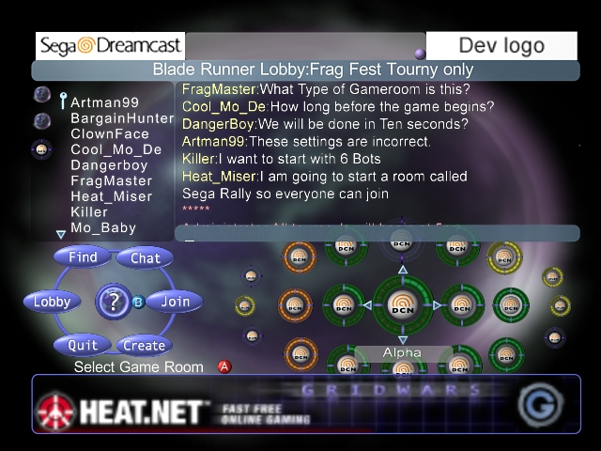
A Lobby View
(choose a game room)
Notes:
Here you see a view of a lobby. The top part of the screen shows a Sega@Dreamcast branding logo. On the right part of the screen is where we would put the game graphic. The space in the middle remains open for some branding or other functionality.
Immediately beneath the branding area we display to the user their location. They are in the lobby "Blade Runner." This lobby has the blurb "Frag Test Tourny only."
At the bottom of the screen we have your standard marketing driven banner ads. If an agreement precludes banner ads this gives us more space for displaying lobby/game room detail.
On the left most side of the screen is a set of tabs. Currently there are only three tabs active: two lobby tabs and one game room tab. By selecting the different tabs we can immediately switch between the different spaces without leaving any of them.
Next to the tab area is a user list. This shows us the list of users in the current space (lobby/game room) that we are looking at. The key next to "artman99" tells us that he is the key holder (if this were a room.. this is a little error in this graphic.)
Beneath the list of users is the command wheel. By pressing the "B" button on the controller our focus moves to the control wheel. Here we can get help, join a game room, move focus to the chat window, create a new game room, quit this lobby, find a lobby, game room, or game instance, or go up to the lobby browser.
Beneath the command wheel is a message telling us what our current focus would do if we pressed the "A" button - "select a game room."
To the right of the command wheel is the view of the game rooms we can see. The game room at the center of the screen is the one we are currently focused on and it is called "alpha." By moving the d-pad in any of four directions we can cause the view of all the game rooms to scroll around.
The color bar around the game room indicates our latency relative to the game room and the players inside of it.

Slide 29
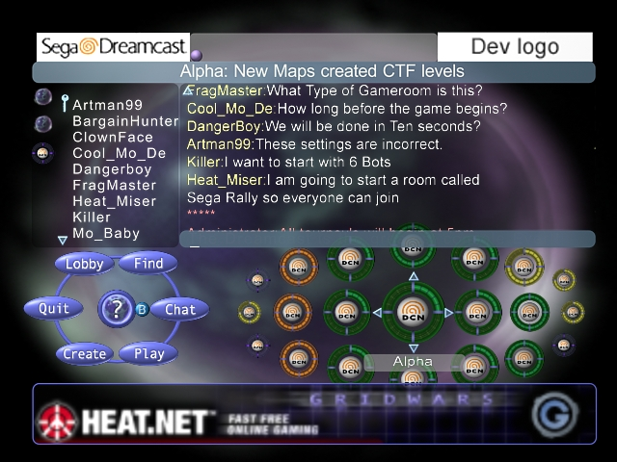
Entering a Game Room
Notes:
Now we have entered a game room. The location bar tells us we are in game room "Alpha" which has the blurb "New Maps created CTF levels"
From here you can see that artman99 is indeed the key holder in this room.
The command wheel has now gotten a "Play" button that we should select when we are ready to play.
The scrolling view of the game rooms to the right of the command wheel lets us jump to other game rooms if we want.
This is probably where the settings for this game will be displayed for this game.

Slide 30
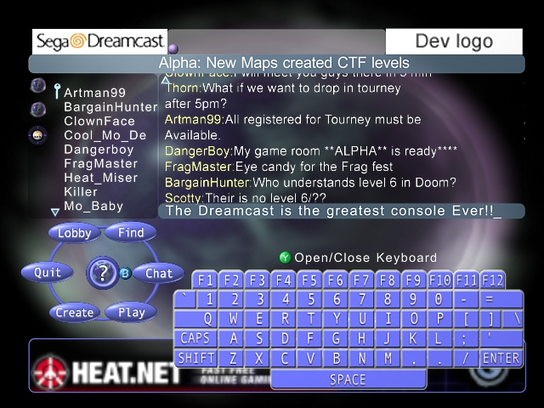
Chatting in a Game Room
Notes:
We are still in the game room "Alpha." Here we have brought up the soft keyboard to send a rather obligatory message how cool this whole network console thing is.

Slide 31
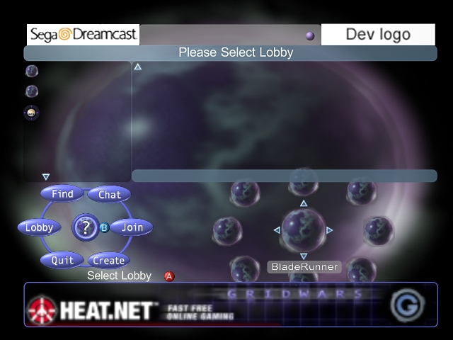
Browsing the Lobbies
Notes:
For one reason or another I want to explore strange, new worlds I zoom back up to the lobby view where I get to browse lobbies.
At this level I am not in any chat room associated with any game room or lobby. If you notice ,though, my tab bar still has in it tabs for two lobbies and one game room. So I still have the option of rapidly toggling back to those locations if I so desire.
You will see that I have currently highlighted the lobby that I was in early, "Blade Runner" and if I press the "A" button I will once again join that lobby.
It is important to note that in phase I of teh Kage toolkit users can not create lobbies.

Slide 32
Table of Contents
What is Kage?
Anatomy of Launching a Network Game
The Kage Client API’s
The Kage Server API’s
A Sample Lobby UI
The Kage Gaming Service
Future Plans
FAQ

Slide 33
What is in the Kage Based Gaming Service
A Preferred ISP Service
Universal Game Network Account
  registration, accounting, etc.
Lobby/Game Room Services
Chat Services
Rebroadcast Services
Hosted Game Servers
DTS Support
End User Support
Notes:
Kage is a toolkit for writing network based multiplayer games. It concentrates on providing the framework to find other players in a very large network. The goal is for games from 2 to 64 players.. as a round number. There is no hard limit on the number of players in a game and you will probably run in to resource constraints on your client before you hit the constraints in the toolkit. Even if you are do there are easy ways to go beyond the limits of anyone component.
However, all the toolkits in the world are not going to help unless you have a gaming network to run them on.
Here is the list of the basic services offered by us as a network service to run your games on.
This is a really general view and does not go in to any of the tricky business details involved in two companies working together to put a network together. I leave that sort of stuff to the businessy types.
We already have with the Dreamcast as it is sold now a preferred ISP service. We take this very carefully in to account when locating our servers to provide the best latency possible.
We will have a universal account structure. A user just needs one account on the "dreamcast network" in order to play any game running on that network. Of course with the strong permission controls we have in lobbys, rooms, and such we restrict it so that only some players seem some areas.
Of course we will have servers that provide the lobby, chat, matchmaking, etc. services.
We will also have servers that are for game play as CMI Session manager providers (ie: servers for doing message rebroadcasting between clients in a game instance.)
In addition if a game developer wants to write a server hosted game - ie a game where the game logic server actually runs on one of our machines we offer that service too. The only API this game service needs to use are the ones in the kgGsv API (and even there we have some flexibility in that we have ways of wrapping already written game servers so they do not need to be modified via the GSV)
Naturally since developing network games is rather difficult and this toolkit can offer a lot of options to the developer we offer developer technical support through Sega of America's DTS operation. They work very closely with us to understand the toolkit and how to use it and what problems people encounter while writing network games.
End User Support - this is a feature of the network service itself. If users use the service they will encounter problems. We work with the support services offered to help track down network problems.

Slide 34
Table of Contents
What is Kage?
Anatomy of Launching a Network Game
The Kage Client API’s
The Kage Server API’s
A Sample Lobby UI
The Kage Gaming Service
Future Plans
FAQ

Slide 35
Future Plans
WinCE/Win32
  Not just Kage, but Dplay and Dlobby S.P.’s
Instant Messaging (all but there)
Ladders, Tournaments (with & w/o persistence)
Interfaces in to the Lobby to display other information
Notes:
The presentation today has just covered what the toolkit and the gaming service can do right now (or rather will do more properly with our Beta release.)
There are obviously a lot of areas to do additional work in.
Yes, we plan on supporting Win32. Not just by compiling the existing Kage API's for Win32 but actually providing service providers for DirectPlay and DirectLobby that will give games that use those API's a seemless interface to the network.
Since Kage offers richer functionality we will have some of the native Kage API's available for doing searches and queries even if you decide to use the DirectPlay and DirectLobby API's.
Since we are offering a full blown gaming network we need to have services that gaming networks have come to expect - such as instant messaging. We have the support for this all in place in the underlying layers but have spent our time concentrating on the basic system first.
Ladders/Tournaments/Ranking/Persistent score reporting. These are features that people clamor for. We already have the basics for doing all of these via the kgGsv API. If your game supports the kgGsv API and uses it for score reporting then you have the basics of what we need to do to support ladders already done.
From within the lobby there could be a wealth of network information the users want to see - their statistics, actual live ladders results being posted graphically, etc. The goal is to make the lobby itself grow as these features are added and you can then subclass the lobby as you see fit to display them.

Slide 36
Future Plans (pt II)
“Privately owned” Lobbies
Buddy lists, Clans
More Hooks in to Flow
Persistent storage
  Serial games, the Virtual VMU
Interfaces to external chat clients
What do we need to have?
Notes:
The killer app of the 90's for those in the online gaming world was not any one game - it was people.
People gather together and they make for themselves a new place on the net. Persistent worlds are all about that. On many chat systems the same users will congregate in the same chat rooms to hang out together.
With Kage as it stands now they could do that by making a named game room and always going to that game room. But we want to go further than that. In the gaming world "clans" have become well recognized as a grouping of players working together. We should offer these clans a place where they can hang out, have their own game rooms, their own ladders and information on display that belongs to them.
In order to have these privately own spaces mean anything we have to have lists of our friends, lists of our acquaintenaces, and groups that can accomdate a large clan. These buddy lists have to become persistent so that when we log on we automatically start searching for friends in our buddy lists and find out where they are, no matter what game they are playing, if they are online using Kage.
There is this backend technology behind Kage that enables it to scale and find resources across a network of thousands of nodes. It is called Flow and as time goes on and users become more interested in a rich online universe bringing more of Flow down to the console for that user to user interaction will help get us to where we are going.
I have listed 'serial games' and the virtual vmu as persistent storage but really it includes things like all of your preferences, your rankings, objects that may be attached to your entity online. By 'serial game' I mean a game that has to be played in stages. Right now we tend to think of this in terms of level games - however Baldur's gate showed us that a multiplayer game can have this sort of state as well. By storing it on the network we can make sure that any of the players can access it no matter who is online or offline.
In the online world there is a term called 'critical mass.' The more users you have online.. the more users you get to stay online. With the dreamcast we have an immediate amount of critical mass.. but would it not be neat to reach in to other systems such as IRC and have people there be able to chat with people inside of one of your games - either sitting in a lobby or wasting Plutonian scum as they try to invade Earth? It may even get some of the people on IRC to go out and buy that game for the dreamcast and play it. Always a good thing for us.
What else do we need to have? We have thousands of ideas having been wanting to work on such things for a long time. I am sure you do as well.

Slide 37
Table of Contents
What is Kage?
Anatomy of Launching a Network Game
The Kage Client API’s
The Kage Server API’s
A Sample Lobby UI
The Kage Gaming Service
Future Plans
FAQ

Slide 38
FAQ
When do we get it?
What does it include?
Does it include sample code?
Can we write our own game servers?
Can we run our own game servers?
What parts are we required to use?
When does phase II happen?
Notes:
Q: When do we get it?
A: Kage is entering its beta period. We can work through SoA DTS with 3rd parties who are extremely interested right now. Our servers will be rolling in to production in June.
Q: What does it include?
A: The SDK includes the client libraries, header files, and documentation for shc and gnu with support for both PlanetWeb and Access. This should include support for the ethernet adapter as well. The SDK will also include client libraries compiled for Solaris 2.6 or 2.7 on the sparc platform. It will include a set of server binaries that run on a sparc solaris platform that provide all lobby, chat, matchmaking and game launch services. You will also get libraries for the server API's as well. These libraries will also be for shc, gnu, and Solaris 2.6/2.7.
Q: Does it include Sample code?
A: Yes, and it will include more as time goes on. The sample game is included.
Q: Can we write our own game servers?
A: Yes. This is the approach we encourage for many reasons. It tends to provide better latency. The servers are more secure. The servers have more cpu. We can actually patch and modify servers after the fact which we can not do if it is on the gd-rom.
Q: Can we run our own game servers?
A: It is theoretically possible. You are going to have to ask the business people for a better answer though.
Q: What parts are we required to use?
A: That depends on what your goals are. If you are not using any Sega services at all you could get away with using none of it. You could just use our session service to register logins and logoffs. You could use just the session and lobby service having your game use no game server services. You could use our game server services, but not use any of our game play protocols, or you could use all of our services. We are flexible and have divied up the modules such that you can pick and choose to an extent.
Q: When does phase II happen?
A: Sorry, we have no real timeline for that, but it should be by Q4 2000. Maybe. Do not hold me to that, I am just a developer. B-)

Slide 39
FAQ (pt II)
What server environment do you support/require?
What about:
  Solaris intel
  (Free,Net,Open)BSD?
  Linux?
  NT / W2k / Win32?
Can a PC play against a Dreamcast?
Notes:
Q: What server environment do you support/require?
A: Currently we support and require Solaris 2.6 and 2.7 running on sun sparcstations. With all of our experience this has been by far the easiest environment to support in production on a very large scale. It also gives us the best performance and support currently.
Q: What about?
A: We have built all of our libraries on top of FreeBSD, Solaris intel, and Linux. Many of our developers work on this in their spare hours at home and run such systems. The only reason we do not release this is we just do not have the man power to test all the configurations and support them on an ongoing basis. If there is some good reason we can work something out I am sure. Eventually we have to support platforms like this?
NT, Win32.. some of our server code that manages the processes is currently very unix based. However that is a very small portion of the entire server suite. It would be possible to support NT game servers although it is not a solution we favor because of the historical immense difficulty maintaining and support such systems. We have learned painful lessons in our previous lives here.
Q: Can a pc play against a dreamcast?
A: If kage exists on the pc platform yes. Since Kage compiles on a dreamcast almost every other system is a cinch to port to. It is mainly just a matter of having the developer write their game to more than one platform.

Slide 40
Yawners / End Material
Sample Game demo
Additional material on some of the problems with writing multiplayer gaming networks.
Notes:
That is the heart of the presentation.
The material that follows is broken up in to two parts - actually demonstrating our sample game that uses the Kage API and
Then we have a bunch of slides covering some of the common problems that have been encountered making multiplayer gaming networks. All of these factors were what guided us in our design of Kage. Some interesting things may be revealed here, but this will only be covered if audience interest warrants.

Slide 41
Sample Game Demo
(GridWars)
Work in progress
Demonstrates how to interface with Kage
Source code is shipped with the SDK
An attempt to challenge the box with more than just “spacewar”
Lobby UI will be abstracted in to its own library for developers to use if they wish
Notes:
The Kage development team has been trying to work on a sample game.
Look at the Kage API's and the flexibility we have as well as some of the unusual approaches we have taken we need something we can show to developers so they can see how to actually make a network game.
First and foremost this is meant to demonstrate a basic lobby UI that begins to show some of the features of Kage. As time goes on this becomes our showcase for new features as well.
We also have the actual game play messages themselves to show one ways a game programmer can write their main event loop as part of a network game.
(this demonstration runs on a pair of set5's so it is hard to encapsulate it in these slides.)

Slide 42
Some Multiplayer Game Network Problems
10’s of Thousands of Players Looking for Each other
Match making effectively with hundreds of servers
No Hard Limit on Number of Simultaneous Players
The UI Middle Ground Between the Game and the Lobby
Patching Games / Backwards Compatible Protocols
Notes:
There are a lot of "challenges" in doing a multiplayer gaming network. Some are less difficult than others. Some we do not know how to solve given the current constraints of information theory and technology.
Handling "logins" to the authentication service is relatively easy. It reduces down to problems for which we have known good solutions.
Handling game play with between 2 and 64 players on a non-distributed game server is fairly easy. THe difficulty is mostly up to the application developer and even there there are some known ways of doing things.
What are the difficult things? Having 10s of thousands of players who share the same 'partition' of the gaming network. Indeed - not having any hard partitioning of the network at all.
Traditional algorithms of pinging the server clusters to find the best match falls apart when the number of clusters increases greatly as well as the number of clients.
Hard limits that are inherent in the design are very difficult to assess if you do not know what they are. A key, though, is whenever you have a single point through which all players must pass. If you can successfully clone that point and keep on doing so without loosing speed/efficiency then you should have overcome at least thata obstacle.
BTW - we do not mean 10's of thousands of people in one game instance. We mean "on the network" in the lobby system.
A problem that plagues heat.net and mplayer is the lack of a nice transition between the game lobby/game room and the game client. This is something that is not as much of a problem with a game on the dreamcast but it is an issue that Kage needs to face for those non-dc games that have the same lobby/game ui split.
One big problem of the console environment - patching. Release it working the first time. However, not all patches are 'bug fixes.' Sometimes we add new features. We have to insure that our servers can speak multiple levels of protocols so that as new features are added to the network old clients do not break yet new clients can use new features. This is especially difficult when the new feature ends up producing a network object that a client using the old protocols may somehow have to interpret.

Slide 43
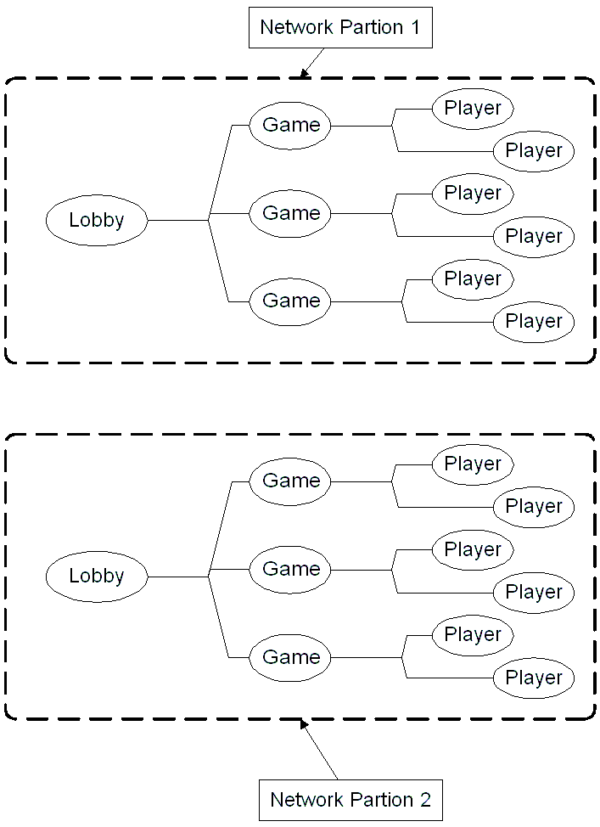
Some Multiplayer Game Network Problems
(finding the needle in the haystack)
Partitioning of a Network Solves Growth Problems
However - Creates Separate Worlds
Difficult For Users to Find Each Other
Notes:
When you have a network of say 10,000 users and they are looking for someone specific it is a fairly easy problem to solve. The search has an understood size that is well within the capabilities of many machines. You could even replicate the entire database across a dozen machines to get some reliability.
However when your network grows to 100,000 simultaneous users the problem becomes a lot more difficult. You could partition this network in to, say, 10 groups of 10,000 players each and you could keep doing this as your active user base grows. However you have now partitioned the net and if two players who desire to meet are on different partitions they will never meet and will need to go outside of the system (or selectively join a partition) in order to communicate.
Usually a single person is only looking for some subset of the entire network. This subset is usually very small.. on the order of 100 to 1000 people. If you could find some way to partition the network dynamically based on this you could
solve two problems at the same time.

Slide 44
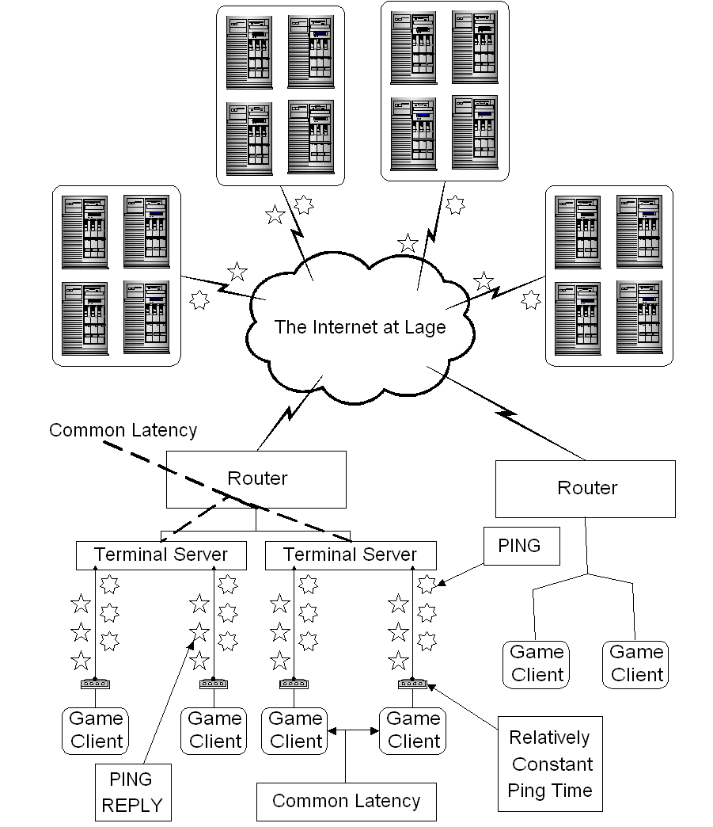
Some Multiplayer Game Network Problems
(determining latency via ping)
Many Game Networks Match by Having Clients Ping Servers
This Presents Problems When There are Too Many Servers
A Single Ping Is not a Good Measure of Network Latency
Ping’ing A Lot of Servers Takes a Long Time
A Single Set of Pings is not a Good Measure of Latency
Some Historical Ping Information Could Go A Long Way
Modem to Dial Up Server Latency is Mostly Constant (so why bother measuring it?)
Notes:
Pinging - the only way to really measure latency between a client and a set of servers is for the client to ping the servers.. or have all the servers ping the client. Since there will be more clients than servers the former is easier to arrange.
However if you just ping the servers once how do you know your measurement was good? Especially on modems - a lot of pings at once can yield poor latency results because the ping packets fill up the modem pipe to the network and they get in the way of their own answers.
Having servers measure latency between themselves does little good as well.
Since most of these boxes will be connected via modem to a terminal server we know that the latency of the link between the modem and the terminal server is pretty much constant for all such boxes. If we were to only ping from the terminal server to the game server will have gotten the same amount of information from the network. We could even get away with generating few pings as it is possible that several modem based clients may share the same terminal server. There may be several terminal servers at the same POP. We could just exchange pings between the router and the servers because the LAN between the terminal server and the router is going to be of negligible delay.
What if we reversed the pings.. from the server to the router.. the servers are always up. They could develop a history chart of which terminal servers have what latency to which servers..

Slide 45
Some Multiplayer Game Network Problems
(hard limits)
Hitting a Ceiling Is Always Bad
You Can Almost Always Patch For Tommorow But the Night Will Never End
A Centralized System Implies a Ceiling
Notes:
This slide rambles a bit.
In short - you need to look at existing systems and see why they are unstable or break under load.
It is not usually a single design decision which leads to this. However there are some single design decisions that if avoided can remove the basis for a lot of failures.
For instance - having a single point which is necessary for multiple operations by a client is bad. If you have to go to some central set of servers whenever you want to launch a game then you will find that getting to that game launch part is where you instability happens a lot.

Slide 46
Some Multiplayer Game Network Problems
(the UI middle ground)
Lobby systems frequently include game rooms
Multiplayer games that require setting options include game rooms as well.
If you have to launch the game from the lobby system there is an annoying pause and switch of UI’s
Notes:
In most pc based game networks that do not have a very tight integration between the game and the lobby service there is usually a launcher program that does the lobby and matchmaking services.
This leads to a rather uncomfortable pass from marshalling the players to playing the game and there is frequently overlap in functionality. For example when you play Total Annihilation on heat.net - you go through heat's lobby and then heat's game room.. and then you launch teh game and you go through TotalA's game room where you set the options.
Starcraft, on battle.net, takes advantage of the limited scope of the lobby system (there are no "rooms" in the lobby system.. if a room is necessary (it is not in diablo, but is in starcraft) then the game is responsible for that room.
This is a problem that we do not believe we will have technically on the dreamcast since we ar eproviding API's for all aspects and the 3rd party developer is responsible for putting whatever UI they want on it.
We do recognize that a number of 3rd parties, however, do not really care or want to be bothered with the whole of the lobby system and will take whatever samples we provide.
So this is the problem of the middle ground for the ui.

Slide 47
Some Multiplayer Game Network Problems
(can not patch a released gd-rom)
Protocol has to have versioning
As new features are added old games must still work
Has to work well the first time - hence long beta & test period (not long enough)
Notes:
There is a fantastic tendency to release games before they are ready.. "we can fix the bugs with patches." Well, hard to do that with dreamcast games.
this is why we have to build in to our protocols robustness. Start with simple fu nctions and make sure the API's and protocols can handle new datatypes that they do not currently support so that old games do not break as new stuff comes out.

